Slide 1



The NET:
VR’s National Employment Team
Kathy West-Evans, MPA, CRC
Director of Business Relations
National Employment Team (NET)
Council of State Administrators of Vocational Rehabilitation

Slide 2

CSAVR: Council of State Administrators of Vocational Rehabilitation
Membership organization of VR Directors
80 agencies: every state, territories, D.C.
Federal/State funded $3.6 billion
25,000 staff
Serve 1.2 million individuals with disabilities per year focused on careers
  Largest talent pool of people with disabilities in the country
  Backed by support of VR leadership, staff and 10,000 community partners.

Slide 3
Demographics: What Does Disability
Look Like in the U.S.?
“Disability is part of the normal human experience.”
1:5 people in the U.S. reports having a disability
Increasing as people age and experience disability
Disability can occur at any time during the employment lifecycle
Disability is the largest diversity group in the U.S. and the one that anyone of us can join at any time.

Slide 4
What is a disability?
Physical
Cognitive
Sensory
Neurological
Other
Mental Health

Slide 5
How might someone become disabled?
Genetic or Congenital (birth)
Conflict
Age
Illness
Accident or Injury
Environment

Slide 6
Customers with Disabilities as a Market Segment
56 million people with disabilities in U.S.
  one-fifth of the population
Aggregate income exceeds $1 trillion
$200 billion in collective spending power
Market enlarged by families, friends, communities, employers, and service providers of people with disabilities
Of 70 million families in the U.S., 20 million have at least one member with a disability
The disability community responds positively to companies whose marketing approaches are sensitive to their needs and interests and those whose workforce reflects their diversity.

Slide 7
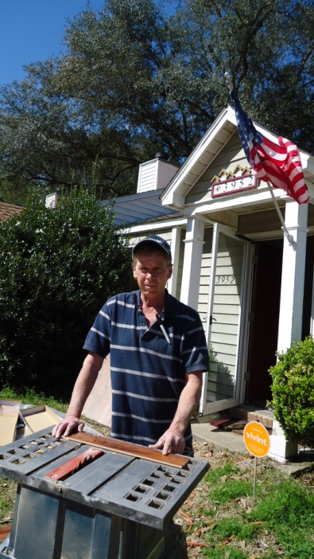


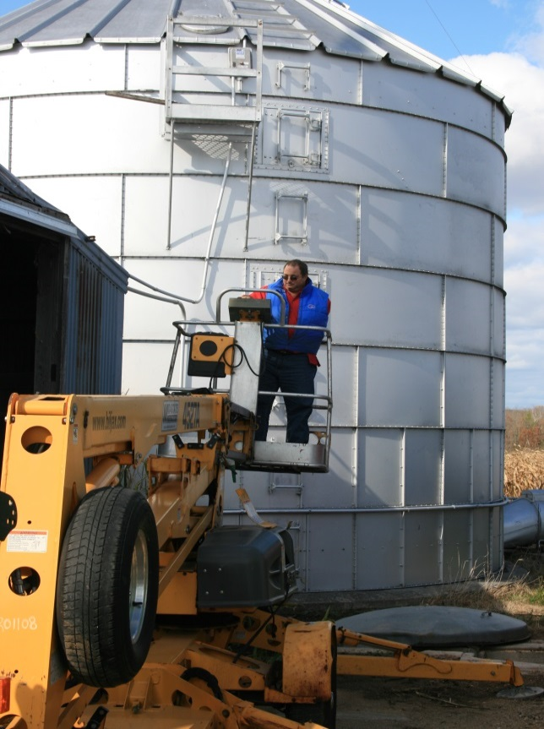
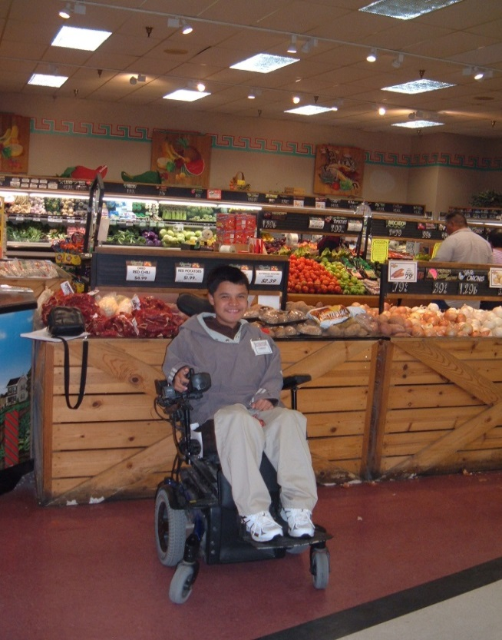
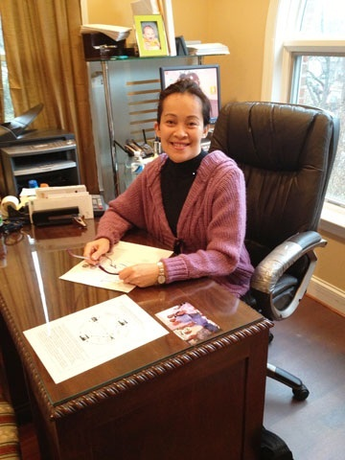

Slide 8
The Rehabilitation Act
Established in the U.S. in 1920, started with Veterans and injured workers
Public input in the reauthorization process
Seven Titles
Individualized approach
Based on the premise that people with disabilities can work and live independently
Vocational Rehabilitation (VR) – Title I
Return on Investment

Slide 9
The Rehabilitation Act:
Section 503

Slide 10
Background Information - 503
Effective on March 24, 2014
Compliance: OFCCP, U.S. Department of Labor
Alignment: established in 1973, updated to reflect new language and legislation focused on the employment of people with disabilities
Coverage: Employers with U.S. federal government contracts or subcontracts of $10,000 or more are covered by the new rules for non-discrimination. Federal contractors with at least 50 employees and a federal contract/subcontract of at least $50,000 must have in place an affirmative action program for hiring individuals with disabilities.

Slide 11
Why the Change and Update?
The percentage of working adults with disabilities remains high. In the Final Rule they referenced 2012 data from the Bureau of Labor Statistics (BLS)
  The workforce participation rate for individuals with disabilities was 31.6% compared to those without – 76.5%.
  The unemployment rate for working age individuals was 15% compare to 8% for those without a disability.
  Median household income for those with disabilities ages 18 – 64 = $25,420 compared to those without at $59,411
  The poverty rate for 18 to 64 was 28.8 % for those with disabilities and 12.5% for those who did not report a disability.
Increasing number of people with disabilities coupled with an increased demand for labor.
New tools and approaches designed to reduce the barriers and increase access to this segment of the labor force.

Slide 12
503 Highlights
Updated definition of “disability” – ADA/ADAAA
Utilization Goals – 7% across a company of 100 of less employees; 7 % by job category for companies with more than 100 employees.
  If utilization goal is not met, why and what is the plan of action?
Invitation to Self-Identify : current employees, applicants and new employees (either pre or post offer), specific language required – OFCCP has provided a Self Identification form. Invite current employees to self identify.
Include Equal Opportunity clause in sub-contracts as well as outreach and advertisements used for recruiting applicants. Subcontractors responsibility.
Quantitative measures and comparisons – applications and hires.
Data collection: number applied/number hired, maintained for 3 years
OFCCP – access to records, on-site or off-site
Notes:
Utilization goals – national; failure to meet is not a violation
Current employees every five years

Slide 13
VEVRAA: Vietnam Era Veterans’ Readjustment Assistance Act
Includes Veterans with disabilities
Hiring benchmark: established by the contractor based on BLS or the national percentage of Veterans in the civilian workforce
Voluntary self-identification
Data collection
EO clause
Records Access

Slide 14
Affirmative Action Plans (AAP) and Reporting
Outreach and recruiting
Documentation of activities and an annual written assessment of the effectiveness
If not effective, identify the alternate efforts
Data analysis:
  Number of applicants who are individuals with disabilities, Veterans
  Total number of applicants for all jobs
  Total number of job openings and jobs filled
  Number of individuals with disabilities and Veterans hired
  Total number of applicants hired
Retain records for three years
For more information: www.dol.gov/ofccp
Notes:
Share Ideas on Resources and Building a Plan

Slide 15

We Asked Our Business Customers
National in Scope
Dual Customer Model
VR as “One Company”
Easily Accessible Network: national VR network with single points of contact
  NET Points of Contact - 80
  “Deliver what you commit to”
  Be Consistent, Reliable and Sustainable
  Community partners-vendor network
Build a Plan with Business – Talent and Services
Leveraging the Strengths of a National System at the State & Local Level
Notes:
2004 – Business Forum, IRI- Common Vision, Action - building an infrastructure for deliverability; define services and protocols, launch a national brand

Slide 16
The NET: VR Business Services
Defined by Business Customers
  Universal Design
    Contracts
    Facilities
    Programs/Services
    Assistive Technology
    Information Technology
  Diversity Programs
  Compliance
    EEO and Affirmative Action
  Legal
    Labor Relations
    Policy Development
    Risk Management
  Product Development
  Customer Service
  Marketing & Outreach
  Pre-Employment
    Internships
    Training
  HR/Staffing
    Recruitment & Promotion
    Benefits & Compensation
    Retention Supports
    Employee Advisory Services
  Accommodations
    Work Site Assessment
    Assistive Technology
  Staff Training
    Disability Awareness
    ADA/Employment Laws
  Financial Supports
    WOTC
    Barrier Removal
Notes:
Business Language – avoid government speak and acronyms

Slide 17

Talent Acquisition Portal (TAP)
Centralize the talent pool - state and national level
Accessible platform
Candidates connect to opportunities
Direct access to candidates with disabilities
Reports – Compliance

Slide 18
NET - Training Center Collaboration
Comprehensive Training Centers
  Arkansas – Hot Springs
  Georgia – Warm Springs
  Kentucky – Thelma
  Maryland - Baltimore
  Michigan – Plainwell
  Pennsylvania – Johnstown
  Tennessee - Smyrna
  Virginia - Fishersville
Business Based Training Models
Apprenticeships
Internships and on-the-job
Virtual Training – Imagine Academy/Boot Camps

Slide 19
Strategic Planning with Business
Understand the business customer
  Key players
  Footprint of the company
  Lines of business
  Employment Needs
  Hiring process
  Work environment
  Culture of the company
  Current diversity and inclusion initiatives – is disability included?
  Where is the company and what are their goals?
  Consider subcontractors and supply chain
Develop a plan with the business based on their goals and footprint
Notes:
Focus on business, not just an employer

Slide 20
Lowe’s: Partnership Agreement
Year 1: 556 hires at corporate, in retail and at distribution centers
States: AL, AK, AZ, AR, CA, CO, CT, DE, FL, GA, IL, IN, IA, LA, MD, MA, MI, MN, MO, MS, NE, NV, NH, NJ, NY, NC, OH, OR, PA, SC, TX, UT, VT, VA WA, WI, WY
Year 2: added focus
  Increased focus on retail sites
  Centralized accommodation unit
    Online application process
    Hiring
    Retention
    National Contract – Interpreters and VRI
    Technical assistance and expertise
  Disability Awareness Package - Company Wide

Slide 21

National Partnership – 250 hires 2015
Retail
Distribution Centers
Pharmacy Tech – Training and Certification
  Local Models and Training Centers
Minute Clinics
Coram
Expansions and Acquisitions (Target)
TAP – streaming positions; hosting Virtual Hiring Events

Slide 22

Business Based Training Model
Business Based Training Program
Training Partner: Hands on Education
Trainees: 18 years of age or older, documented disABILITY, able to perform functions of job; no Felonies within past 7 years; no HS Diploma or GED is required
910 graduates – 250 hired by Hyatt + those hired by other businesses in the hospitality industry
FL (8), DC/MD/VA (3), CO (3), PA, MO, TX (9)
WA (3), CA (5), MN and AZ next phase

Slide 23

Starbucks
Inclusion Academy – Carson Valley, Nevada
  5 Classes: 28 students, 23 graduates
  21 Hires: 14 hired at Starbucks, 7 hired by other businesses
  Summer (high school) and Retail pre-employment training
Inclusion Academy – York, PA
  2 Classes
  10 hires
  New location – projecting 100 hires from VR, partnering on transportation
Corporate Hires
In Development:
  Roasting Plant – Sandy Run, SC
  Retail Training – Maryland
  Retail Training – Fully Accessible Mobile Site
  Veterans – Wounded Warriors and Transitioning Students

Slide 24


NET - VR Business Partnerships
Hershey: PA – model to VA, KY, IL
Microsoft: Neurodiversity – WA/National
  Accessibility
  Talent Pipeline
Boeing
Notes:
Section

Slide 25
For More Information
Kathy West-Evans, MPA, CRC
Director of Business Relations
National Employment Team (NET)
206.999.9455
Kwest-evans@rehabnetwork.org
www.csavr.org
Janet Drudik
Program Director
Nebraska VR
Phone: 402.484.1908
janet.drudik@nebraska.gov

